Slide 1
Strategic Excellence
Prof. Marwa Tarek
3rd class
External Strategic Management Audit

Slide 2
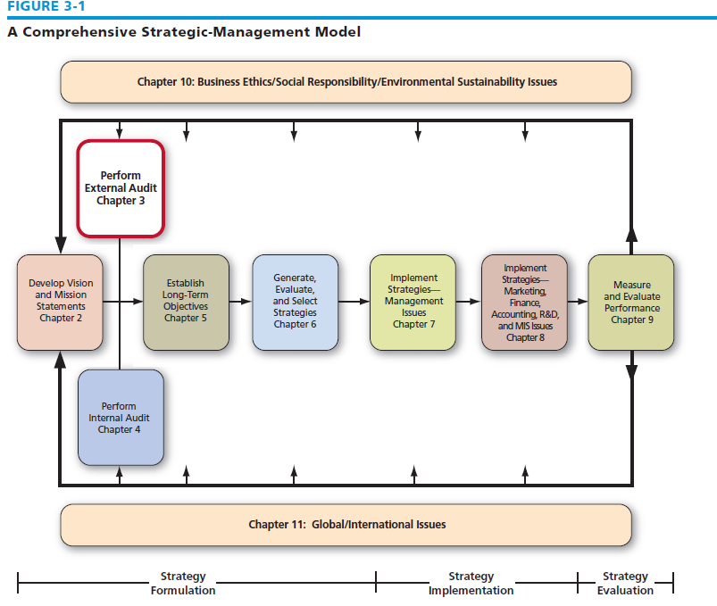
External Strategic Management Audit

Slide 3
External Strategic Management Audit
Purpose of an External Audit
Focusing on identifying and evaluating trends and events beyond the control of a single firm.
Developing a list of the following:
- opportunities that could benefit a firm.
- threats that should be avoided.

Slide 4
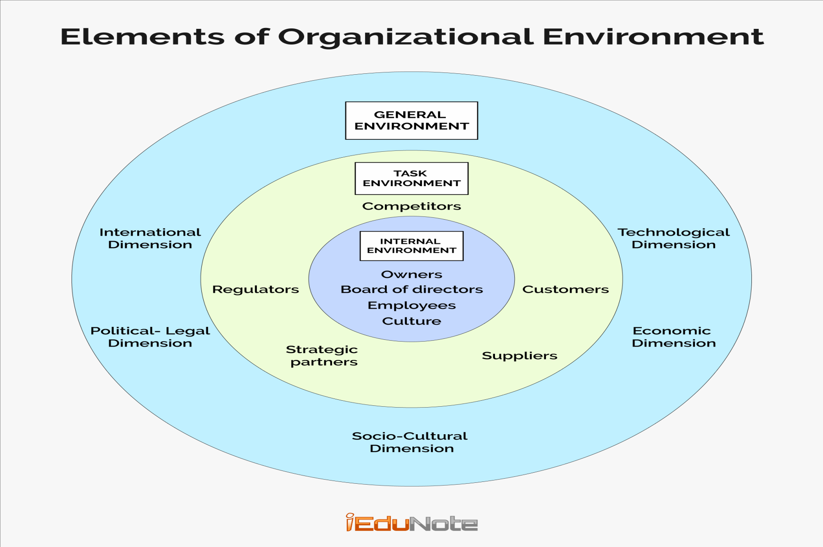
Identifying Environmental Variables
Societal environment

Slide 5
External (Societal) Strategic Management Audit
It includes general forces “PEST” :
Political-legal forces that allocate power and provide constraining and protecting laws and regulation
Economic forces that regulate the exchange of materials, money, energy and information
Sociocultural forces that regulate the values and customs of society
Technological forces that generate problem-solving inventions

Slide 6
External (Societal) Strategic Management Audit

Slide 7
International Societal Considerations
Differences in societal environments strongly affect the ways in which a Multi-National Corporation (MNC)conducts its marketing, financial, manufacturing, and other functional activities.
For example, In terms of sociocultural variables, many Asian cultures (especially China) are less concerned with the value of human rights than in European and North American cultures.
Before planning its strategy for a particular international location, a company must scan the particular country environments for opportunities and threats, and compare these with its own strengths and weaknesses.

Slide 8
Task environment
Groups that directly affect a corporation and are affected by the corporation:
Government
Local communities
Suppliers
Competitors
Customers
Creditors
Unions
Special interest groups/trade associations

Slide 9
Sources of External Information: - Unpublished Sources
Customer surveys
Market research
Speeches at professional or shareholder meetings
Television programs
Interviews and conversations with stakeholders

Slide 10
Sources of External Information: - Published Sources
Periodicals
Journals
Reports
Government documents
Abstracts
Books
Directories
Newspapers
Manuals

Slide 11
Sources of External Information: Web Sites
http://marketwatch.multexinvestor.com
http://moneycentral.msn.com
http://finance.yahoo.com
www.clearstation.com
https://us.etrade.com/e/t/invest/markets
www.hoovers.com

Slide 12
Forecasting Tools and Techniques
Forecasts are educated assumptions about future trends and events
Quantitative techniques – most appropriate when historical data is available and there is a constant relationship.
Qualitative techniques
Qualitative analysis uses subjective judgment to analyze non-quantifiable information, such as management expertise, industry cycles, strength of research and development, and labor relations. Qualitative tools represent opinions or feelings and cannot be represented by a numerical statistics.
Qualitative analysis contrasts with quantitative analysis, which focuses on numbers found in reports such as balance sheets.
The two techniques, however, will often be used together to examine a company's operations and evaluate its potential as an investment opportunity.

Slide 13
Industry Analysis: The External Factor Evaluation (EFE) Matrix
An External Factor Evaluation (EFE) Matrix allows strategists to summarize and evaluate economic, social, cultural, demographic, environmental, political, governmental, legal, technological, and competitive information. EFE Matrix indicates whether the firm is able to effectively take advantage of existing opportunities along with minimizing the external threats.

Slide 14
Industry Analysis: The External Factor Evaluation (EFE) Matrix
Economic
Social,
Cultural,
Demographic,
Environmental,
Political,
Governmental,
Legal,
Technological,
and Competitive Information.

Slide 15
Industry Analysis: The External Factor Evaluation (EFE) Matrix
An External Factor Evaluation (EFE) Matrix can be developed in five steps:
1- List key external factors, including both opportunities and threats affecting the firm and its industry.
List the opportunities first and then the threats.
Be as specific as possible, using percentages, ratios, and comparative numbers whenever possible.

Slide 16
Industry Analysis: The External Factor Evaluation (EFE) Matrix
2- Assign to each factor a weight that ranges from 0.0 (not important) to 1.0 (very important).
The weight indicates the relative importance of that factor to being successful in the firm’s industry.
This means that the weight is industry-based, the relative importance of each external factor according to the related industry.
Appropriate weights can be determined by comparing successful with unsuccessful competitors or by discussing the factor and reaching a group opinion.
The sum of all weights assigned to the factors must equal 1.0.

Slide 17
Industry Analysis: The External Factor Evaluation (EFE) Matrix
3- Assign a 1 to 4 rating to each key external factor to indicate how effectively the firm’s current strategies respond to the factor, where 4 = the response is superior, 3 = the response is above average, 2 = the response is average, and 1 = the response is poor.
Ratings are based on effectiveness of the firm’s strategies.
Ratings are thus company-based, whereas the weights in Step 2 are industry-based.
It is important to note that both threats and opportunities can receive a 1, 2, 3, or 4.

Slide 18
Industry Analysis: The External Factor Evaluation (EFE) Matrix
4-Multiply each factor’s weight by its rating to determine a weighted score.
5-Sum the weighted scores for each variable to determine the total weighted score for the organization.

Slide 19
(EFE) Matrix
1. List key external factors
2. Assign a weight that ranges from 0.0 (not important) to 1.0 (all-important) to each factor
3. Assign a 1-to-4 rating to each factor to indicate whether that factor represents a strength or weakness
4. Multiply each factor’s weight by its rating to determine a weighted score for each variable
5. Sum the weighted scores for each variable to determine the total weighted score for the organization

Slide 20
(EFE) Matrix
Regardless of the no. of key opportunities and threats included in an (EFE) Matrix, the highest possible total weighted score for any organization is 4.0 and the lowest possible total weighted score is 1.0, whereas the average total weighted score is 2.5.

Slide 21
(EFE) Matrix
A total weighted score of 4.0 indicates that an organization is responding in an outstanding way to existing opportunities and threats in its industry. In other words, the firm’s strategies effectively take advantage of existing opportunities and minimize the potential adverse effect of external threats.
A total score of 1.0 indicates that the firm’s strategies are not capitalizing on opportunities or avoiding external threats.

Slide 22
To get more accurate decision concerning the weights and the ratings of EFE, we need to participate with the experienced personnel (ex. Selecting 10 members of the strategists) to get separated EFE from each participants, then discussing every single O and every single T and then every single weight and every single rating in order to develop a consolidated EFE that re-represents the single organization which is much more objective than the EFE which is developed by each single member.

Slide 23
(EFE) Matrix

Slide 24
(EFE) Matrix

Slide 25
(EFE) Matrix

Slide 26
(EFE) Matrix and IFE Matrix
The External Factor Evaluation (EFE) Matrix is similar to Internal Factor Evaluation (IFE) Matrix. The major difference between the EFE matrix and the IFE matrix is the type of factors that are included in the model. While the IFE matrix deals with internal factors, the EFE matrix is concerned with the external factors.

